Slide 1

SAI VIDYA INSTITUTE OF TECHNOLOGY
Department of Computer Science and Engineering
Rajanukunte, Bengaluru - 560064
Technical Seminar on
Unmanned Aerial Vehicle Object Detection and Recognition using Deep Learning
Under the guidance of
Sreelatha P K
Assistant Professor
Department Of CSE
By
Darshika B 1VA18CS009

Slide 2
Presentation Outline
Introduction
Related Work
Architecture/other diagrams
Algorithm/Modules
Advantages and Disadvantages
Applications
Conclusion
References
Results
Dept. of CSE, SVIT 2

Slide 3
Introduction
System is developed to analyse the images obtained From UAVs and to find solutions to the existing problem arises an great interest. For example: Solutions are proposed for the processing of images obtained by UAV in many fields such as land object recognition, building recognition and so on.
UAVs are which can fly autonomously or semi-autonomously without any operator are an important factor in object recognition and detection.
Today, with the help of Deep learning algorithms, which is one of the Machine Learning Methods , object detection and recognition are performed faster and more efficiently.
In this study , it is suggested to keep the threat elements to be detected at the time of discovery and observation more comprehensively. High accuracy rate is of great importance in deep learning applications.
Dept. of CSE, SVIT 3

Slide 4
RELATED WORK
In this study , a database consisting of 11 different threating images have been prepared. To begin with, CNNs, one of DL strategies, are utilized to prepare for ML in the proposed strategy .
Deep Learning architectures Faster-RCNN and YOLOV4 are used for object detection and recognition, the classification of the type of objects is carried out by using the Darknet architecture.
Object Detection and recognition were performed using images obtained by IHA that have been prepared utilizing 2595 photographs
The innovation for identifying and creating awareness is being judged utilizing military activity photograph and information caught by UAVs. As a result, the accuracy rates of suggested deep learning methods were compared and the outputs related to performance analyses were presented
Dept. of CSE, SVIT 4

Slide 5
System Model
STEP 1 - Object Detection and recognition were performed using images obtained by IHA that have been prepared utilizing 2595 photographs
.STEP 2 - As a result, the accuracy rates of suggested deep learning methods that is Faster-RCNN were compared with YOLO V4 and the outputs related to performance analyses were presented .While the Faster-RCNN engineering scored a precision pace of 93% in object location ,the YOLOV4 design procured an exactness pace of 88%.
Dept. of CSE, SVIT 5

Slide 6
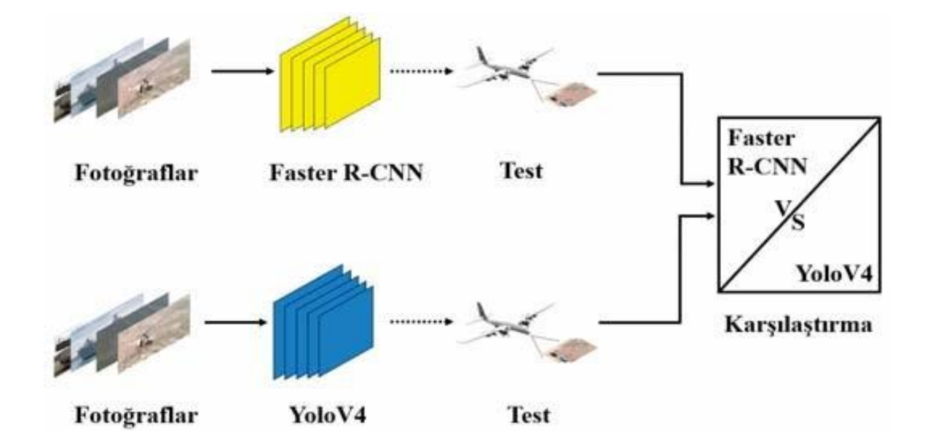
System Model
Dept. of CSE, SVIT 6

Slide 7
MODULES
In the first place, CNNs, one of the profound learning strategies, are utilized to prepare for AI on the items in the proposed procedure. It is trusted that by utilizing the FasterRCNN and YoloV4 profound learning designs, the precision accomplished all through the preparation stage can measure up.
CNN
CNNs (CNN) are used in a range of applications. It is, besides a doubt, the most extensively used deep studying architecture.
CNN is additionally pretty environment friendly in phrases of computing. It performs parameter sharing and makes use of exclusive convolution and pooling algorithms. This approves CNN fashions to run on any device, making them attractive to a vast vary of users
Overall, We're working with a very superb and environment friendly mannequin that makes use of automated function extraction to attain superhuman accuracy (yes CNN fashions now do picture classification higher than humans).
Dept. of CSE, SVIT 7

Slide 8
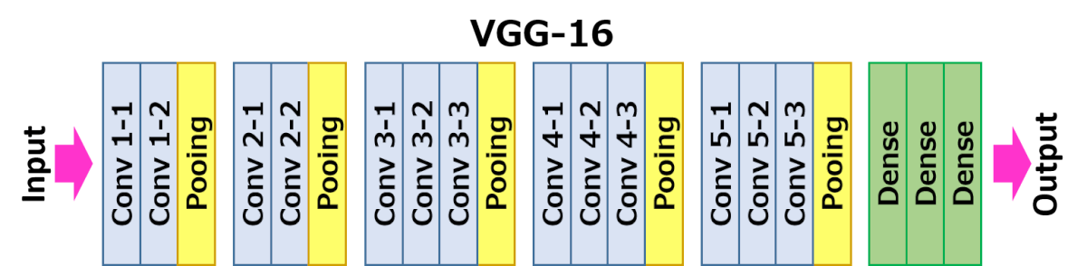
MODULES
CNN
Faster-RCNN
The first model used for machine learning is trained to recognize 11 different threatening elements. The training is on the graphical processing unit (GPU) to make the process go faster. A virtual environment is created
Image processing was performed using images taken from the UAV. In this study, firstly, the Faster-RCNN model is one of the deep learning architectures in machine learning algorithms, is used
Once image converted to matrix format is passed through the CNN. As output, feature map is obtained. Pooling is done to equalize the dimensions of the picture without losing its properties .
Dept. of CSE, SVIT 8

Slide 9
MODULES
YOLOV4
YOLOv4 is a one-stage object detection model that improves on YOLOv3 by including a plethora of tricks and modules from the literature. The tricks and modules used are described in greater detail in the components section below. YOLOv4: Fastest and Most Accurate Object Detection
Dept. of CSE, SVIT 9

Slide 10
ADVANTAGES AND DISADVANTAGES
Advantages
The military and defense sectors
Security
Easily Deployable
Disadvantages
Privacy
Dept. of CSE, SVIT 10

Slide 11
APPLICATIONS
Agriculture
Crop monitoring(Diseases ,insects)
Chemical Application(Fertilizer , pesticide)
Land Management(Soil Moisture ,Drainage Issue)
Humanitarian Efforts
Hazard Monitoring
Emergency Delivery
Disaster Mapping
Dept. of CSE, SVIT 11

Slide 12
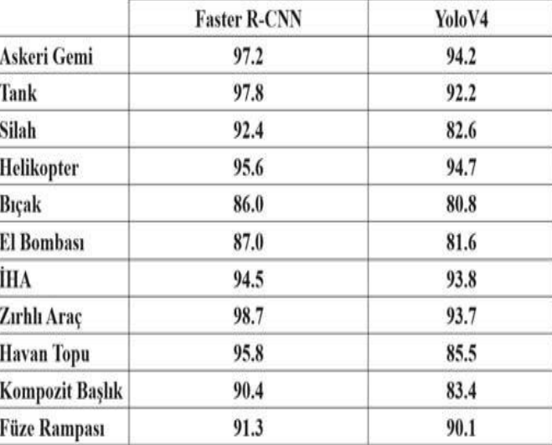
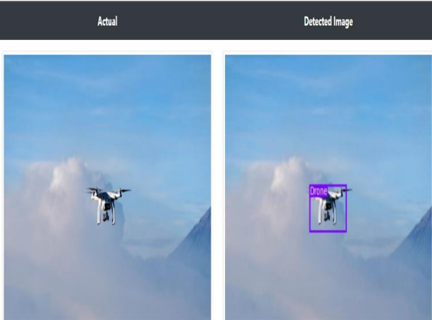
Results
The system predicts the unmanned aerial vehicles called drones and these results are generated and saves output images with respective class_ID .
Dept. of CSE, SVIT 12

Slide 13
CONCLUSION
It is critical in this study for the military and defense sectors.
. We describe a deep learning-based detection and recognition approach. type. Deep learning techniques' CNNs Using the YoloV4 and Faster-RCNN models of the process's accuracy rates were compared.
Threatening 2595 pictures obtained by IHA are utilized for identification and recognition of elements in military operations. In the Faster-RCNN architecture, object detection and recognition are roughly 93 percent accurate.. In the YoloV4 design, the validity ratio is roughly 88 percent. Accuracy was achieved. When all parameters are considered, the Faster-RCNN training model looks to perform better.
Dept. of CSE, SVIT 13

Slide 14
REFERENCES
[1] S.A Lyasheva, , M.V. Medvedev, and M.P. Shleimovich, “Terrain Object Recognition in Unmanned Aerial Vehicle Control System,” Russ. Aeronaut, 57, 303-306, 2014.
[2] F. Lin, X. Zheng and Q. Wu, "Small object detection in aerial view based on improved YoloV3 neural network," in Proc. IEEE Int. Conf. on Ad- vances in Electrical Engineering and Computer Applications (AEECA), pp. 522-525, 2020.
[3] Y. Liu, "An Improved Faster R-CNN for Object Detection", 11th Inter- national Symposium on Computational Intelligence and Design (ISCID), Hangzhou, China, pp. 119-123, 2018.
Dept. of CSE, SVIT 14

Slide 15

THANK YOU!!

